Slide 1
Balancing tags using sampling methods

Slide 2
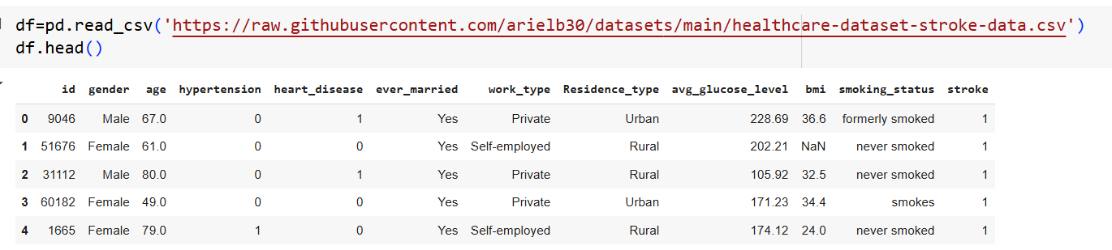
Stroke Prediction dataset

Slide 3
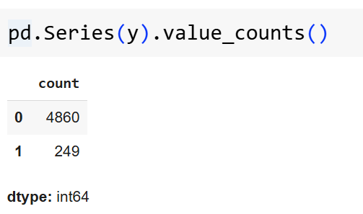
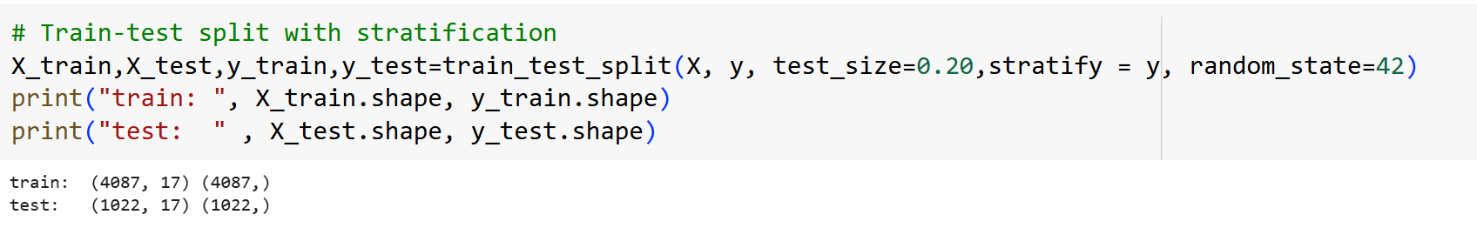
Unbalanced dataset
מומלץ לשנות stratify = y

Slide 4
Using standard Pipeline and GridsearchCV scoring=‘accuracy’
from sklearn.pipeline import Pipeline
pipeline = Pipeline([
('scaler', MinMaxScaler()),
('knn', KNeighborsClassifier()),
])
param_grid = {
'knn__n_neighbors': [x for x in range(1,51,5)],
}

Slide 5
Using standard Pipeline and GridsearchCV scoring=‘accuracy’
from sklearn.model_selection import GridSearchCV
# GridSearchCV with F1 score (good for imbalanced data)
grid = GridSearchCV(pipeline, param_grid, scoring='accuracy', cv=5, n_jobs=-1)
# Fit grid search
grid.fit(X_train, y_train)
# Best parameters and best CV score
print("Best parameters:", grid.best_params_)
print("Best CV F1 score:", grid.best_score_)

Slide 6
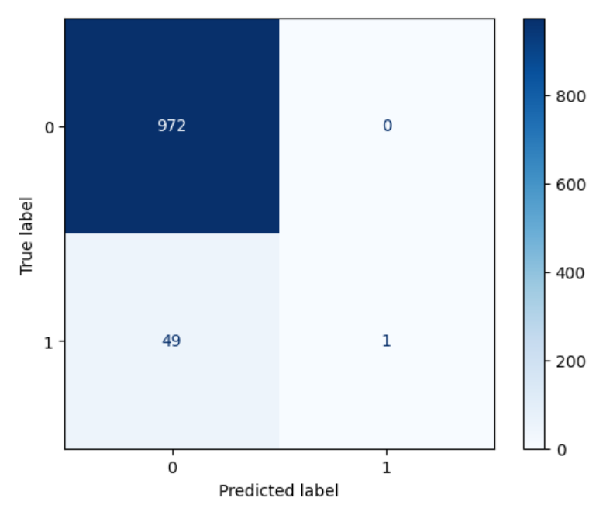
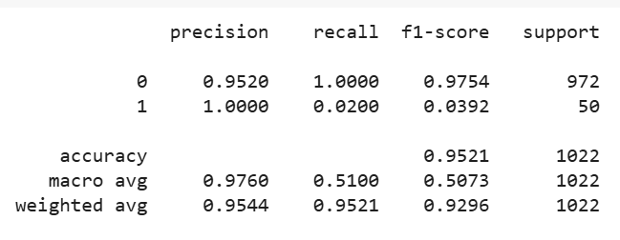
Using standard Pipeline and GridsearchCV scoring=‘accuracy’
grid = GridSearchCV(pipeline, param_grid, scoring='accuracy', cv=5)

Slide 7
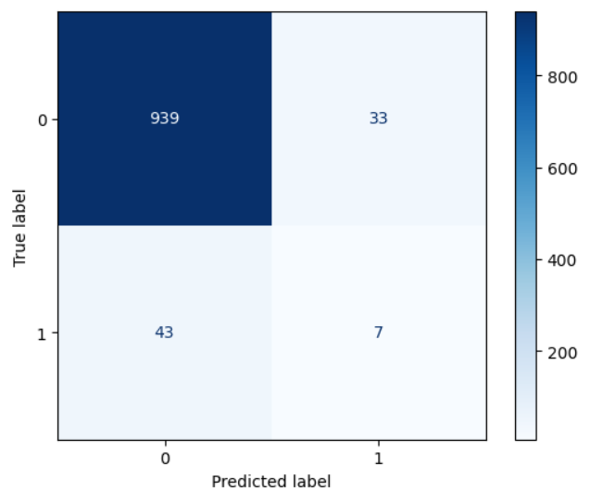
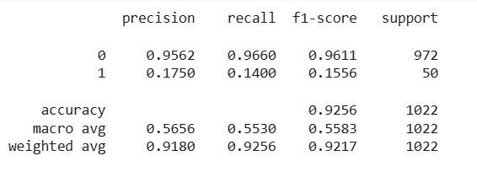
Using standard Pipeline and GridsearchCV scoring=‘f1’
grid = GridSearchCV(pipeline, param_grid, scoring=‘f1', cv=5)

Slide 8
Sampling methods
Undersampling - reduces the number of majority class samples to balance the dataset, often at the cost of losing information.
Oversampling - duplicates existing minority class samples to balance the dataset, which can lead to overfitting.
SMOTE - (Synthetic Minority Over-sampling Technique) generates new, synthetic minority class samples by interpolating between existing ones, improving balance without exact duplication.

Slide 9
Balancing tags using SMOTE
מומלץ לשנות stratify = y

Slide 10
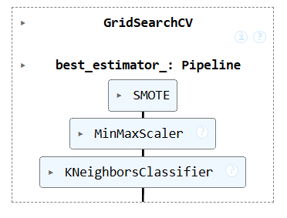
Balancing tags using SMOTE
from imblearn.pipeline import Pipeline
from imblearn.over_sampling import SMOTE
pipeline = Pipeline([
(‘SMOTE', SMOTE(random_state=42)),
('scaler', MinMaxScaler()),
('knn', KNeighborsClassifier()),
])
param_grid = {
'knn__n_neighbors': [x for x in range(1,51,5)],
}

Slide 11
Balancing tags using SMOTE
from sklearn.model_selection import GridSearchCV
# GridSearchCV with F1 score (good for imbalanced data)
grid = GridSearchCV(pipeline, param_grid, scoring='f1', cv=5, n_jobs=-1)
# Fit grid search
grid.fit(X_train, y_train)
# Best parameters and best CV score
print("Best parameters:", grid.best_params_)
print("Best CV F1 score:", grid.best_score_)

Slide 12
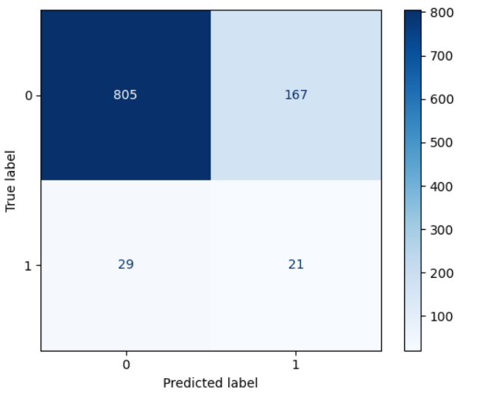
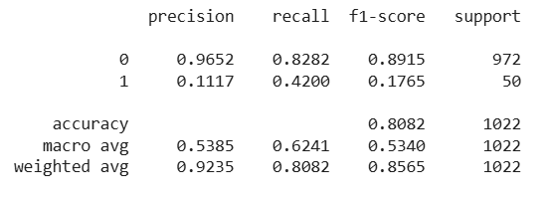
Balancing tags using SMOTE

Slide 13
Balancing tags using Under Sampling
מומלץ לשנות stratify = y

Slide 14
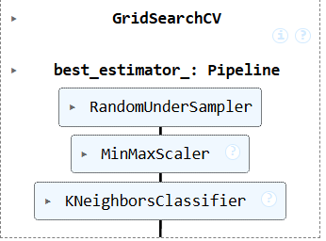
Balancing tags using Under Sampling
from imblearn.pipeline import Pipeline
from imblearn.under_sampling import RandomUnderSampler
pipeline = Pipeline([
('under', RandomUnderSampler(random_state=42)),
('scaler', MinMaxScaler()),
('knn', KNeighborsClassifier())
])
param_grid = {
'knn__n_neighbors': [x for x in range(1,51,5)],
}

Slide 15
Balancing tags using Under Sampling
from sklearn.model_selection import GridSearchCV
# GridSearchCV with F1 score (good for imbalanced data)
grid = GridSearchCV(pipeline, param_grid, scoring='f1', cv=5, n_jobs=-1)
# Fit grid search
grid.fit(X_train, y_train)
# Best parameters and best CV score
print("Best parameters:", grid.best_params_)
print("Best CV F1 score:", grid.best_score_)

Slide 16
Balancing tags using Over Sampling
מומלץ לשנות stratify = y

Slide 17
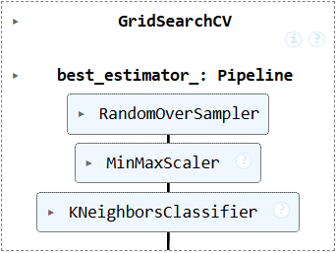
Balancing tags using Over Sampling
from imblearn.pipeline import Pipeline
from imblearn.over_sampling import RandomOverSampler
pipeline = Pipeline([
('over', RandomOverSampler(random_state=42)),
('scaler', MinMaxScaler()),
('knn', KNeighborsClassifier())
])
param_grid = {
'knn__n_neighbors': [x for x in range(1,51,5)],
}

Slide 18
Balancing tags using Over Sampling
from sklearn.model_selection import GridSearchCV
# GridSearchCV with F1 score (good for imbalanced data)
grid = GridSearchCV(pipeline, param_grid, scoring='f1', cv=5, n_jobs=-1)
# Fit grid search
grid.fit(X_train, y_train)
# Best parameters and best CV score
print("Best parameters:", grid.best_params_)
print("Best CV F1 score:", grid.best_score_)

Slide 19
הדגמות Balancing tags
SMOTE notebook here
UnderSampling notebook here
OverSampling notebook here

Slide 20
תודה על ההשתתפות

